Slide 1
Basic Internship@Clevered AI App/ Project Name
App User Manual
Author: Kartik Singh

Slide 2
Table of Contents
Acknowledgements
About Me..
About My Internship with Clevered..
About App..
How do I use the App?
Contact Person

Slide 3
Acknowledgements
A small vote of thanks for all who have helped you in this journey of App Development – your parents, Mr Ken, Clevered, Mentors, Group Members, Friends, Sites etc.

Slide 4

About Me..
Student’s Photograph
Student’s Introduction
My name is Kartik, and I am an enthusiastic coder eager to explore the vast world of programming. With a natural preference for problem-solving and logical thinking, coding has become my passion and creative outlet

Slide 5
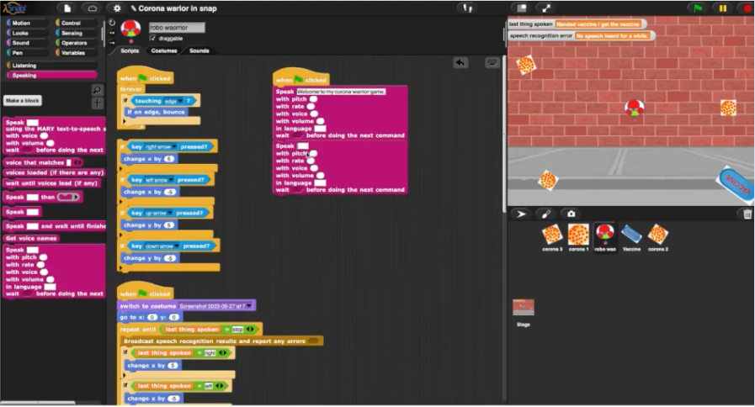
About My Internship with Clevered..
Any photographs from sessions etc.
Your internship experience with Clevered
I'm delighted to share that I'm thoroughly enjoying my internship experience. It's been a rewarding journey filled with valuable learning opportunities and exposure to real-world challenges. I feel fortunate to be part of such a supportive and dynamic team, and I look forward to continuing to grow both personally and professionally throughout this internship.
Badges Earned
1.Rockstar Badge(Attentiveness)
2. Rockstar Badges (Wonderful efforts for project completion)

Slide 6
About App..
App’s Introduction
Introducing "Corona Defender: The Vaccine Quest" – a thrilling and educational mobile app designed to simulate the urgent mission of a brave digital character battling the deadly COVID-19 virus. In this captivating game, players embark on a high-stakes adventure, guiding the protagonist through challenging levels as they strive to evade the virus and acquire the life-saving vaccine before their health depletes to zero. Will you be the hero to lead the fight against the virus, or will COVID-19 prevail? Join the quest to save yourself from the clutches of the corona and secure the elusive vaccine before it's too late! Embark on this thrilling adventure and become a Corona Defender today.

Slide 7
How do I use the App?
There are some things before playing this game :
1.Internet should be perfect
2.Your mic should be working properly
There will be 2 options to play the game
1. You can use your voice to move the robot UP, DOWN, LEFT, RIGHT.
2. You can say the key word which will activate you arrow keys to play in the game “Arrow Keys”
3. Try to get the vaccien before the corona touches you and your health goes down to 0

Slide 8
Contact Person
Please reach out to student name at student’s email address for any questions/ concerns/ suggestions on the App
Kartik Singh
Kartik0412009@gmail.com

Slide 9
Thank you!

